Slide 1
Introduction to digital signal processing in MATLAB

Slide 2
Table of content
Analog signals
Introduction
Features
Pros and cons
Digital signals
Introduction
Analog to digital conversion
Features
Pros and cons

Slide 3
Analog signals
Scalars or multi-dimensional values that continuously change over time conveying information about specific physical phenomena.
Usually, signals are acquired by means of dedicated sensors.
Examples:
Audio
Electrocardiogram (ECG)
Seismic signals
2D/3D examples:
Images and Videos
Notes:
Examples of natural phenomena and their acquisition methods. Signals only represent the part of the phenomena that the sensor can acquire.
These are both time-varying signals, however space-varying signals can be considered as well.

Slide 4
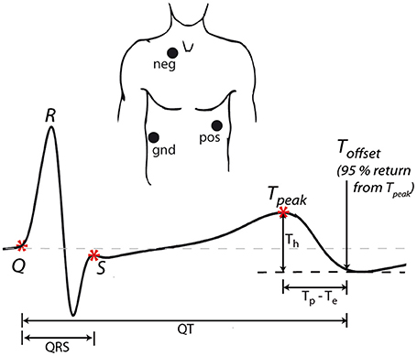
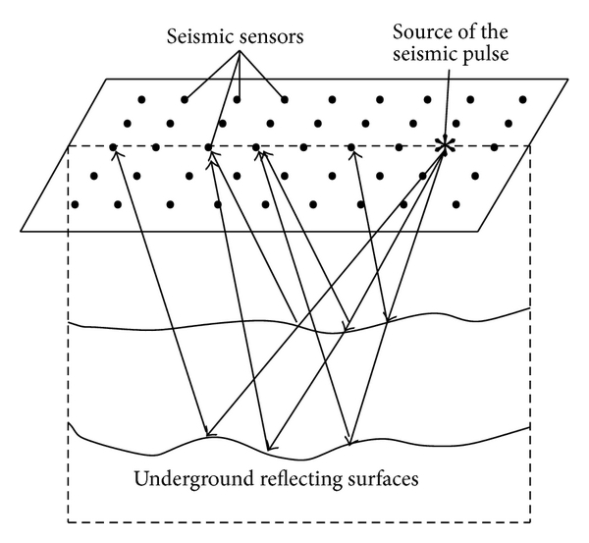
Analog signals acquisition examples
ECGs
The electrical signals, which cause the heart to beat, are acquired by placing electrodes on the subject’s chest
The ECG is cheap and unharmful, thus it is largely used for heart-related medical diagnosis
Seismic signals
Underground oscillations can be measured through geophones or hydrophones
The seismic signals carry information about the sources (e.g., earthquake) or mean (e.g., material)
Notes:
ECG is the running example of this course. Many different pathologies can be spotted through ECG. Examples of seismic signal visualization and processing can be found in the "Signal Processing onramp" MATLAB course.

Slide 5
Analog signals: features
Features describe the characteristics of the signal. Examples of features can be:
Duration in seconds (for finite duration signals)
Amplitude variation range Minimum and maximum values that the signal can reach
Possible periodicity Does the signal repeat itself after a determined interval?
Variation speed How fast the amplitude changes in time (measured in terms of frequency components of the signal)
Notes:
Amplitude variation range is sometimes called peak-to-peak value.
Frequency analysis will be presented in the next sub-module (1b).

Slide 6
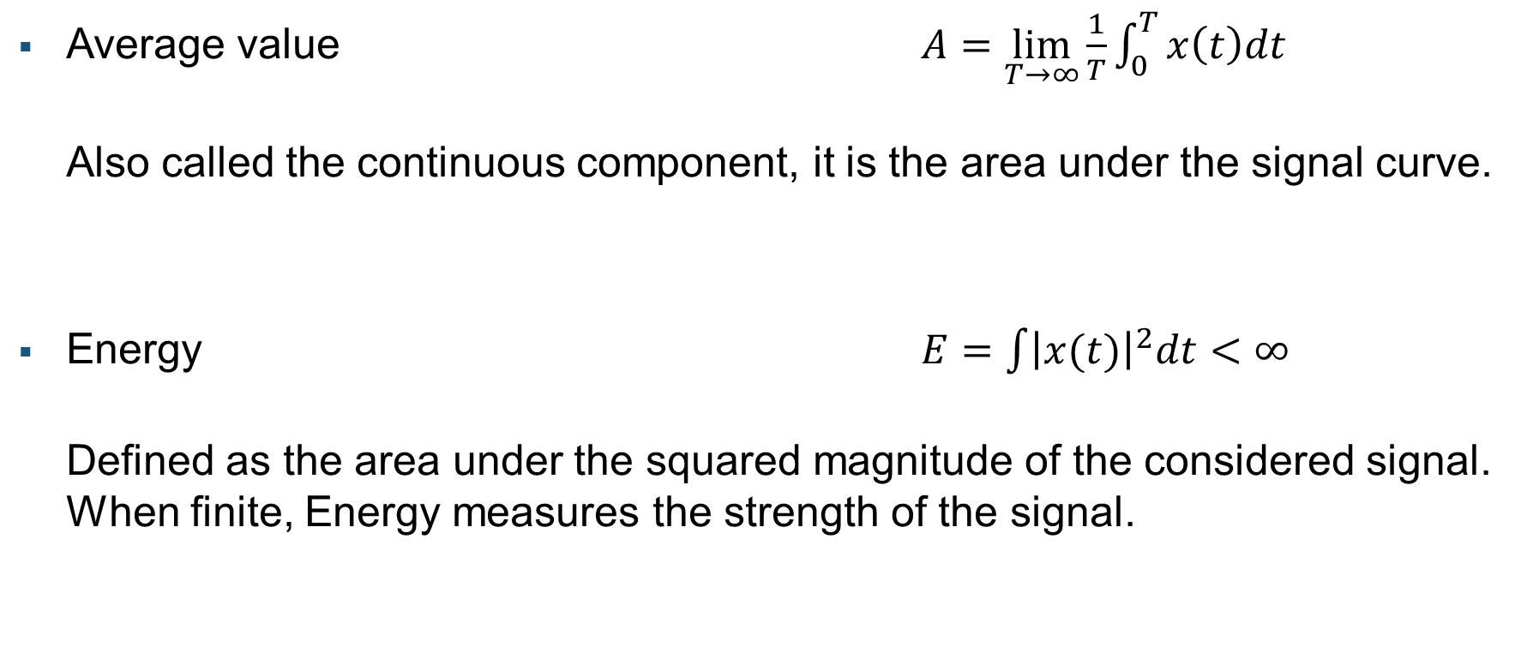
Analog signals: numerical features
Average value $A=\lim_{T→∞}{\frac{1}{T}}\int_{0}^{T}{x\left(t\right)dt}$ Also called the continuous component, it is the area under the signal curve.
Energy $E=\int{{\left|x(t)\right|}^{2}dt}<∞$ Defined as the area under the squared magnitude of the considered signal. When finite, Energy measures the strength of the signal.
Notes:
Numerical features commonly used to describe the strength of the signal. Energy should be considered only when it is finite. For example, unlimited signals like periodical ones often have Energy equal to infinity.

Slide 7
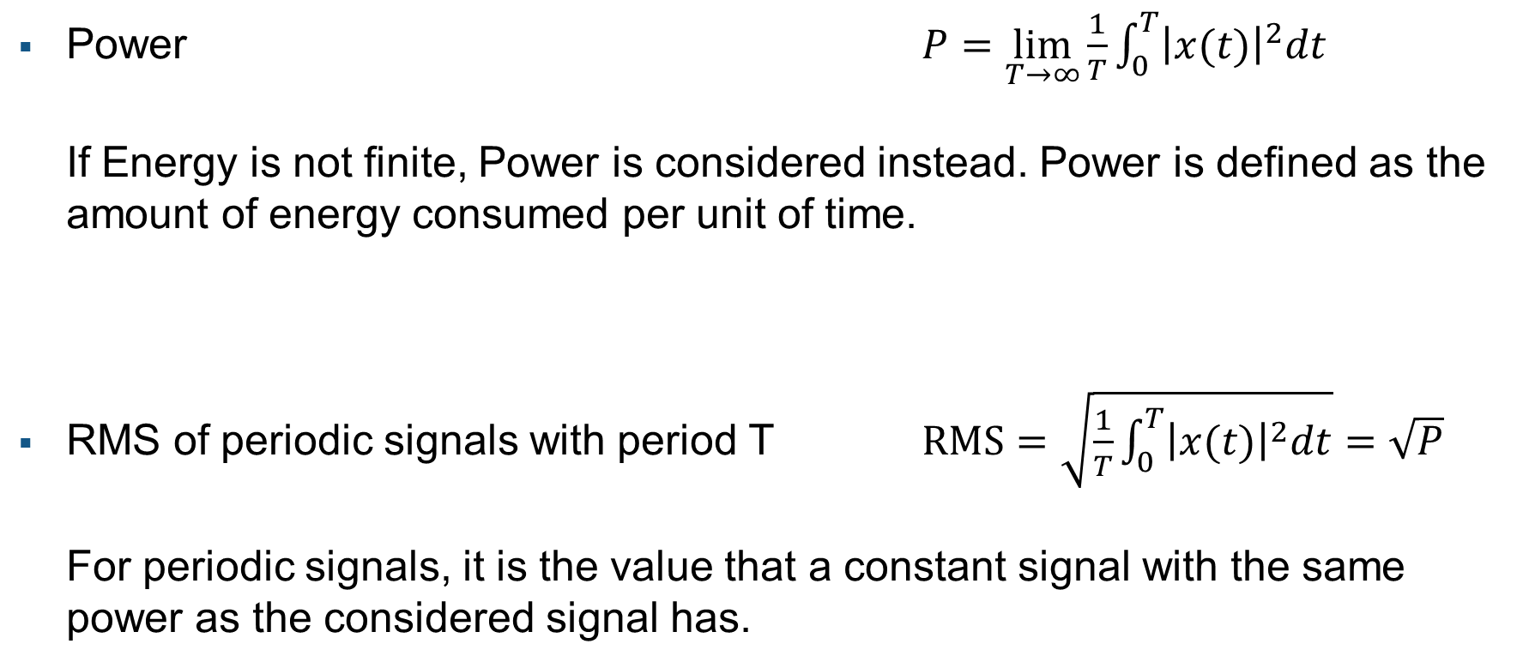
Analog signals: numerical features
Power $P=\lim_{T→∞}{\frac{1}{T}}\int_{0}^{T}{{\left|x(t)\right|}^{2}dt}$ If Energy is not finite, Power is considered instead. Power is defined as the amount of energy consumed per unit of time.
RMS of periodic signals with period T $RMS=\sqrt{\frac{1}{T}\int_{0}^{T}{{\left|x(t)\right|}^{2}dt}}=\sqrt{P}$ For periodic signals, it is the value that a constant signal with the same power as the considered signal has.
Notes:
In that case, the Power is computed, instead.
For periodical signal, another characteristic feature is the Root Mean Squared value.

Slide 8
Pros and cons of analog signals
Exact representation of the physical phenomena
No information loss
Needs analog memories to be stored, which are subject to noise and errors
Are difficult to process
Notes:
Analog signals is the most informative description that we can acquire about the physical phenomenon.
However, they should be stored into analog memory supports, which are slow, subject to aging and difficult to preserve.
Moreover, an analog signal are mostly processed through dedicated circuits, which is costly and difficult to update.

Slide 9
Digital signal
A digital signal has values in a pre-defined range and at specific times.
Usually, it is the discretized version of an analog signal.
The analog to digital conversion follows specific rules.
Notes:
Digital signals are arrays of values of a certain types. Most of the natural signals are analog signals, which we then convert into digital.

Slide 10
Analog to digital conversion
Unlimited memory would be necessary to store and process unlimited real-valued samples of the analog signal.
Conversion steps:
Sampling: only take a limited number of samples at specific times
Quantization: convert real values to floating-point values
Notes:
Analog to digital conversion is a very well-studied procedure which basically is composed by two steps: sampling and quantization.

Slide 11
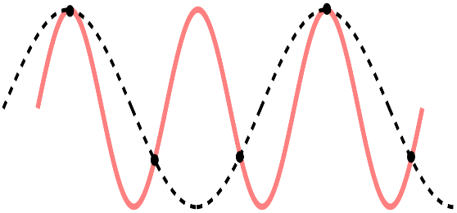
Analog to digital conversion: sampling
It is the discretization of the time (or independent) variable. Samples are picked with at constant/regular interval/frequency.
The sampling frequency is a trade-off between information to retain and resources needed to store/process the digital signal
The rationale: the faster the signal variation, the higher the required frequency sampling (at the cost of more resources)
The sampling theorem (a.k.a. Nyquist-Shannon theorem) defines the minimum sampling frequency for perfect reconstruction of the analog signal
Notes:
Sampling is the most important step of the analog to digital conversion. In the next sub-module (1b), the sampling theorem and the aliasing effect will be presented.

Slide 12
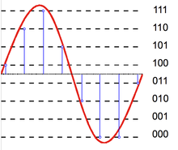
Analog to digital conversion: quantization
It is the discretization of the amplitude (or dependent) variable. Picked samples are represented in a digital format.
Involves a limited distortion/information loss
is equivalent to the addition of a noise:
lower and less correlated with the signal the finer the quantization
higher and more correlated with the signal the coarser the quantization
Ad-hoc quantization methods can be performed based on signal statistics
Notes:
Quantization depends on the kind of application. E.g., multimedia signals usually undergo a stronger quantization for online streaming applications in order to reduce the needed resources.

Slide 13
Array representation
Finally, the digital signal is represented through:
The array containing the quantized signal values
An (optional) array storing the time at which each sample is picked. Alternatively, the initial time and the sampling interval/frequency are stored.
Notes:
Beyond the amplitude array, it is useful to store the time array to efficiently perform time axis operations like time shift, reflection, and so on.

Slide 14
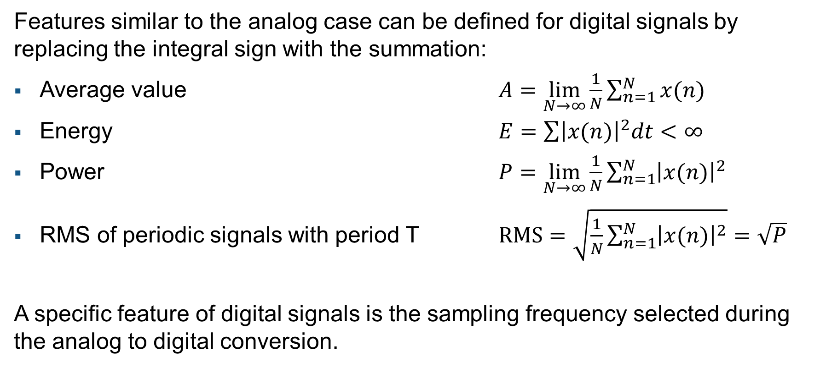
Digital signals: features
Features similar to the analog case can be defined for digital signals by replacing the integral sign with the summation:
Average value $A=\lim_{N→∞}{\frac{1}{N}}\sum_{n=1}^{N}{x(n)}$
Energy $E=\sum{{\left|x(n)\right|}^{2}dt}<∞$
Power $P=\lim_{N→∞}{\frac{1}{N}}\sum_{n=1}^{N}{{\left|x(n)\right|}^{2}}$
RMS of periodic signals with period T $RMS=\sqrt{\frac{1}{N}\sum_{n=1}^{N}{{\left|x(n)\right|}^{2}}}=\sqrt{P}$
A specific feature of digital signals is the sampling frequency selected during the analog to digital conversion.
Notes:
Numerical features of digital signals are computed by replacing the integral operator with a summation.
The same considerations can be done.

Slide 15
Pros and cons of digital signals
Easy to store into digital memories as arrays
Can be processed via software algorithms
A correct sampling frequency should be selected to avoid distortion
Analog to digital conversion always involves some controllable information loss
Notes:
Digital signals have great advantages. They can be easily stored and processed by digital systems. Algorithms can be updated easily.
On the contrary, the cons are that we should carefully choice the sampling frequency in order to avoid distortion. This can be done by studying the analog signal. Moreover, quantization always involves some information loss, but this can be controlled.

